Slide 1
Preliminary Utah Analytics

Slide 2
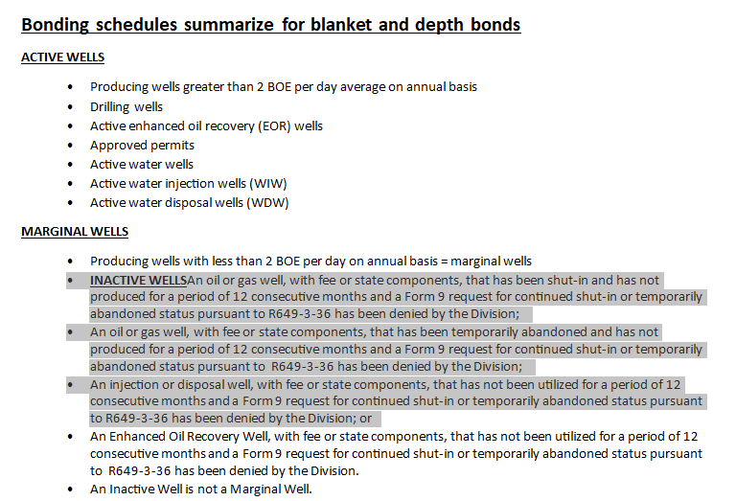
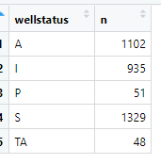
UPA Proposal
How do we know if a Form 9 request has been approved or denied in the data?
When I look in the data, among wells that have reported zero production in 12 months, 51 are labeled as “Producing.” Are the wells labeled as either “S” or “TA” the wells that had this form approved?

Slide 3
Preliminary Analysis
Assumptions:
I calculate bonding amounts as if we were instituting the law on 1/1/2024. So, I look at production data from 01/01/2023 through 12/31/2023. Wells are labeled marginal or inactive if they are oil or gas wells that produce less than 2BOE per day or if they are labeled as 'shut-in,' 'temporarily abandoned,' or 'inactive.’
Importantly, there are a lot of injection and disposal wells in the state. My read of the rule is that these should be bonded under this rule, and that they need to be covered by the marginal/inactive well bond if they have been inactive for more than 12 months. However, I don't have any data on when these wells transitioned from active --> inactive so I need to label them as inactive if that's their labeled well status. This means that I'll slightly overcount some injection and disposal wells in the marginal/inactive well bond.
To calculate counterfactual bonding amounts under the UPA proposal, I only count wells as “inactive” if either they are oil/gas wells that haven’t produced for at least 12 consecutive months, or if their labeled status is inactive service well. Importantly, this will overstate the bonds under the UPA redline since many of these wells will have a Form 9 approval.

Slide 4
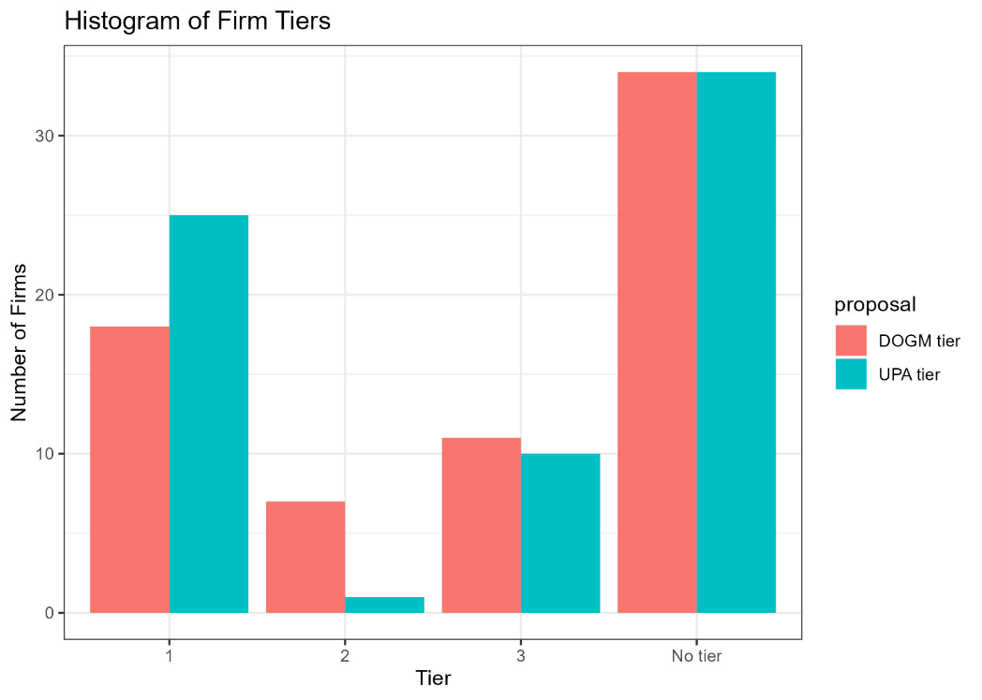
DOGM vs. UPA
Our calculations suggest that the current DOGM proposal would collect $51 million in bonds while the UPA redline would collect $45 million.
Again, our calculation of the UPA redline might be a vast over-statement since we don’t observe which inactive wells have an approved Form 9.

Slide 5
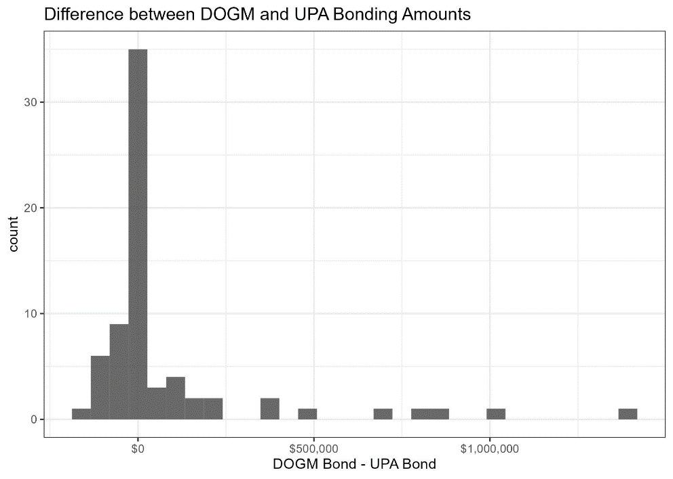
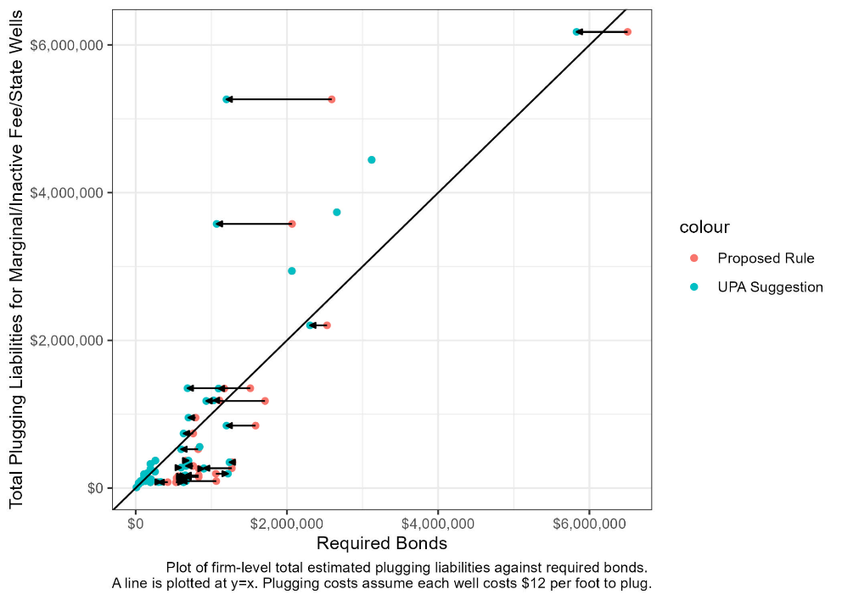
DOGM vs. UPA

Slide 6
Open Data Questions For DOGM
Can you observe Form 9 applications/approvals/rejections in the current data? If so, where?
What about well-level injection and storage volumes? We see that there’s some monthly-level data but is there a way to link this with API numbers?
Does everything here look reasonable?

Slide 7
Limitations
This quick analysis estimates how much each firm would owe if the new bonds were put into place on 1/1/24.
Ignores firm responses to new policies.
  By creating tiers, you generate incentives for firms to lower their inactive and marginal well counts.
  The decision to bond marginal wells under blankets or inactive/marginal well bonds will have an effect on whether producers choose to shut-in or TA wells.
Ignores how changes to bonding regulations affect transfers between firms

Slide 8
Thank you!

